Slide 1

Continuous Integration and Continuous Delivery using AWS CodePipeline
Prepared by:
Michael Meluso mmeluso@jhctechnology.com
GitHub: https://github.com/melusom/CodePipeline

Slide 2
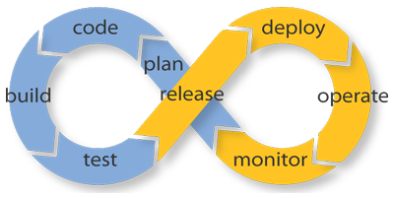
What is Continuous Integration/Delivery?
A change in culture and practices
Break your large, infrequent code changes into smaller, more frequent changes
Continuous testing, continuous feedback
Notes:
What does CI/CD mean to you?
More agile
Testing, results (raw data), analyzed to produce findings, turned into action items, pushed to code

Slide 3
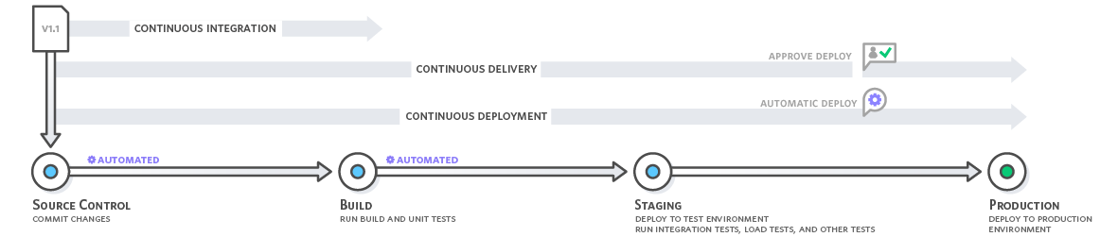
Continuous What?

Slide 4

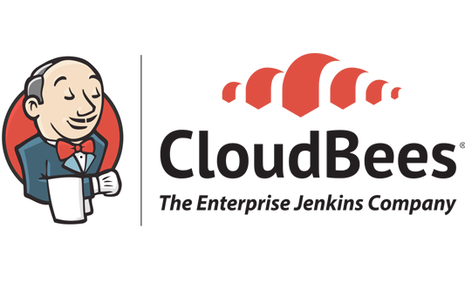



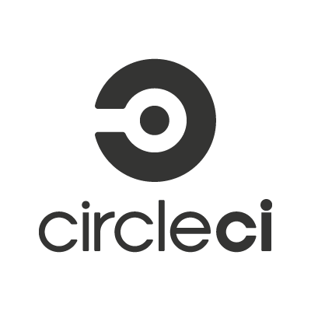
What is Jenkins?
Automation tool – jobs triggered manually or event-driven
Open source, available for free - jenkins.io
Build and test, highly extendable
Other flavors available, as well as other CI solutions

Slide 5



What You’ll Need
Code Repository
Jenkins Server
AWS Account
AWS CodePipeline
AWS CodeCommit

Slide 6
Choosing a Repo
Industry standard
Low cost, fully featured
Lowest cost
AWS CodeCommit
Public: Free
Individual: $7
Organizations: $25 first 5, $9/user after
Enterprise: $25/user in
10 packs
Per-user/month pricing
$1/user (first 5 free)
$0
Data storage pricing
Unlimited
10 GB/user incl., $0.06/GB month after
-
$0.023 per GB/month for first
50 TB (first GB free)
Request pricing
2,000/user/month incl., $0.001 per Git request after
$0.005 per 1,000 PUTs, $0.004 per 10,000 GETs,
DELETES free
Unlimited
Git-compatible, GUI, in-transit encryption,
third-party integrations
Git-compatible, GUI, at-rest and in-transit encryption, 11 9’s durability, 4 9’s availability, AWS events
AWS command line interface, GUI, at-rest and in-transit encryption, 11 9’s durability, 4 9’s availability, AWS events
Capabilities
Notes:
All support versioning

Slide 7
Demo

Slide 8
Where to Learn More
This Demo on GitHib
AWS CodePipeline Tutorial
Jenkins
AWS CodeCommit
CloudFormation vs Terraform
Custom CodePipeline Actions with AWS Lambda
CloudFormation Deployment with CodePipeline
CodePipeline and Jenkins Walkthrough

